Slide 1

H1 2023 Insights & Recommendations
Engagement Analysis
Andrew Gerson – Data Team

Slide 2
Table of Contents
Overview
Context & Key Metrics
Insights
Recommendations
Appendix
Technical Process, Caveats & Additional Data

Slide 3
Overview

Slide 4
Context
Project Aim:
Analyze the performance of the Top 500 titles during H1 2023
83 Films, 417 TV seasons
Provide recommendations for future acquisitions and project development
Objectives:
Drive new signups
Retain existing subscribers
Increase brand awareness

Slide 5
Key Metrics
Total Views
Views Per Day
Number of times a title was viewed from start to finish.
For TV, 1 view represents a viewing of every episode within that season.
Number of times a title was viewed for each day available (max 180 days).
Watch Rate
Percentage of 240m global subscribers who watched.

Slide 6
Key Metrics
Total Views
Views Per Day
Combined, total views: 3.12B
Film average: 37.5M
High: 130.4M
Low: 16.6M
TV average: 10.5M per season
High: 99.8M
Low: 0.1M
Film average: 0.4M
High: 7.09M
Low: 0.09M
TV average: 0.1M
High: 1.81M
Low: 493 (not a typo!)
Watch Rate
Film average: 15.6% of subscribers
High: 54.3%
Low: 6.9%
TV average: 4.37%
High: 41.6%
Low: 0.0%

Slide 7
Insights

Slide 8
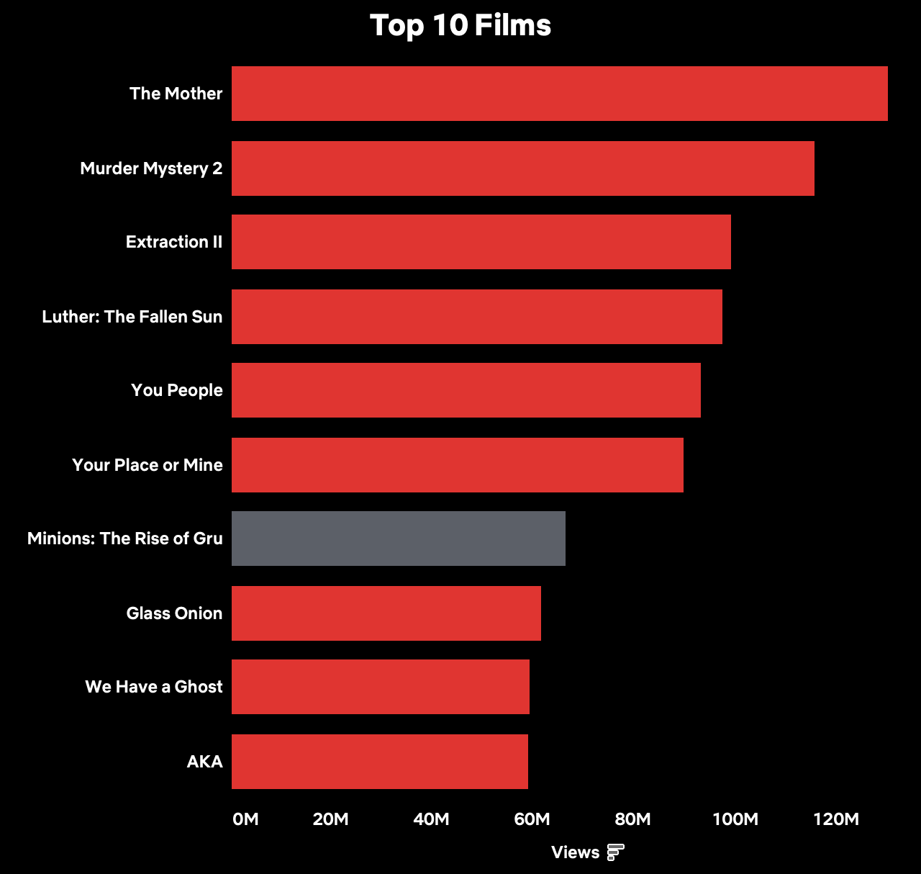
Netflix Original action & crime films drove engagement.
THE MOTHER was the most popular title overall, with 130.4M views in just 49 days.
Of the Top 10 films, 8 are classified as action or crime films (the remaining 2 are rom-coms) .
WE HAVE A GHOST and AKA (a French Film) were the only films not to feature a well-known star in the cast.
MINIONS was the only acquisition in the Top 10. Every other film was produced by Netflix.
Only 2 of the Top 10 were on Netflix for the duration of H1.

Slide 9
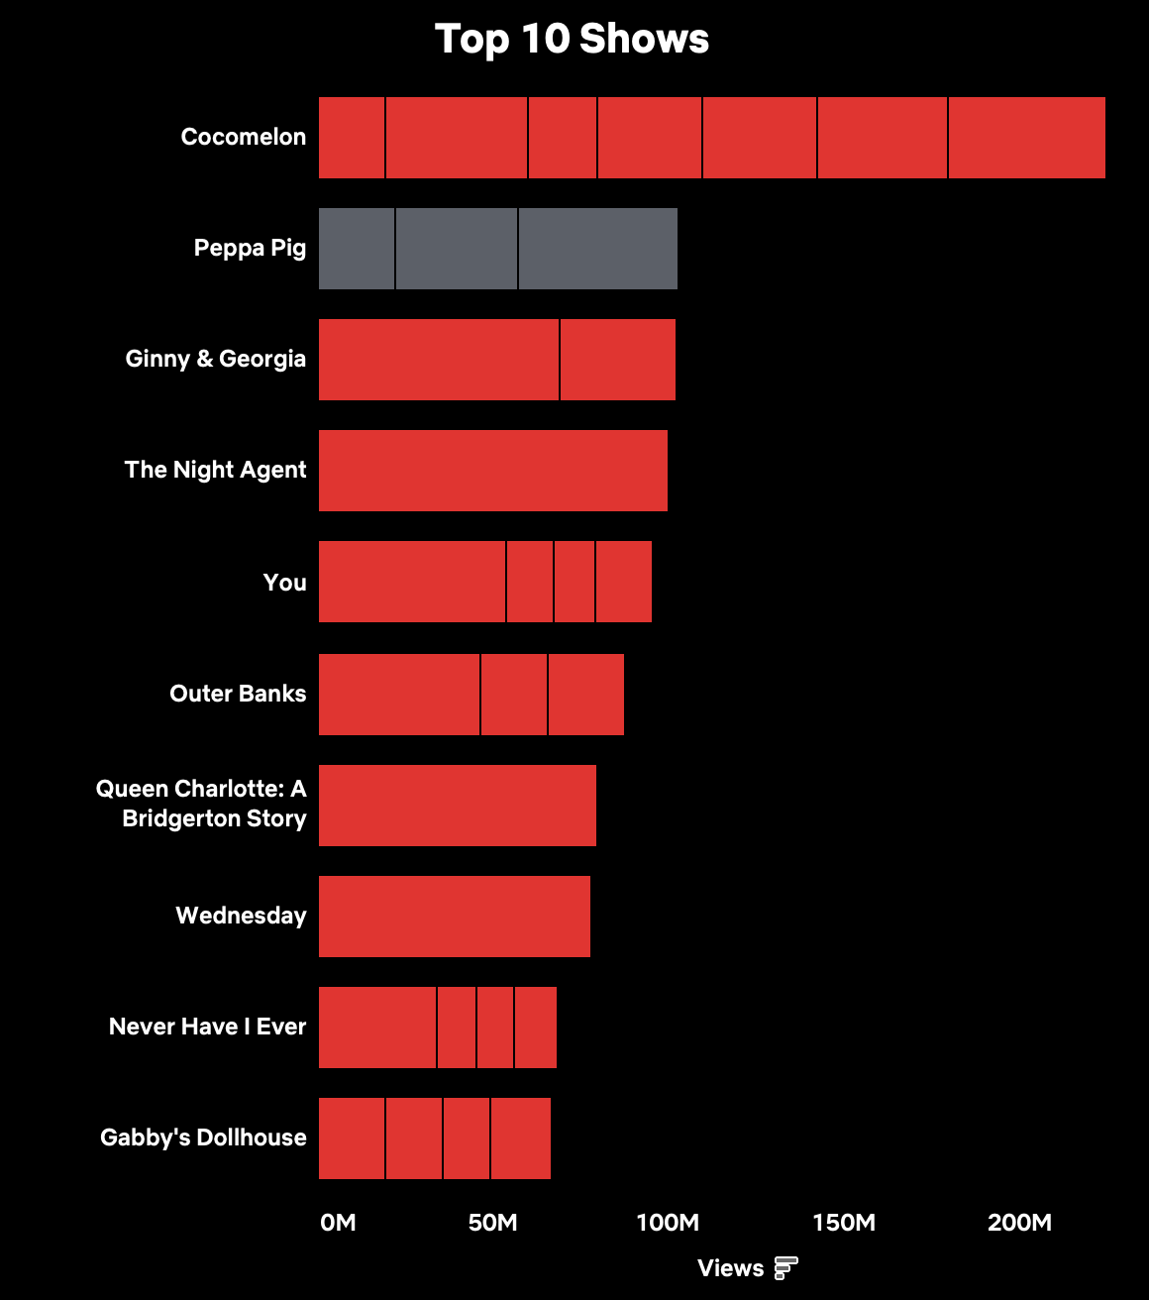
Children’s programming, well-established series, and massive hits drew TV viewership.
Combining all seasons, Cocomelon accumulated over 200M views. Children’s shows in the top 10 are responsible for over 350M views.
3 of the Top 10 are shows in their 1st season, and each occupies a different genre space and target audience. These seasons have viewership equivalent to an above-average film.
The Night Agent is the only Top 10 show that premiered in 2023 and was not based on pre-existing IP.
Outside of the Top 10, multiple true crime and sports documentaries performed well in daily viewing metrics.
Within the top 30 shows with multiple seasons, 8 were hit shows acquired from linear networks (NBC, USA, AMC, etc.)

Slide 10
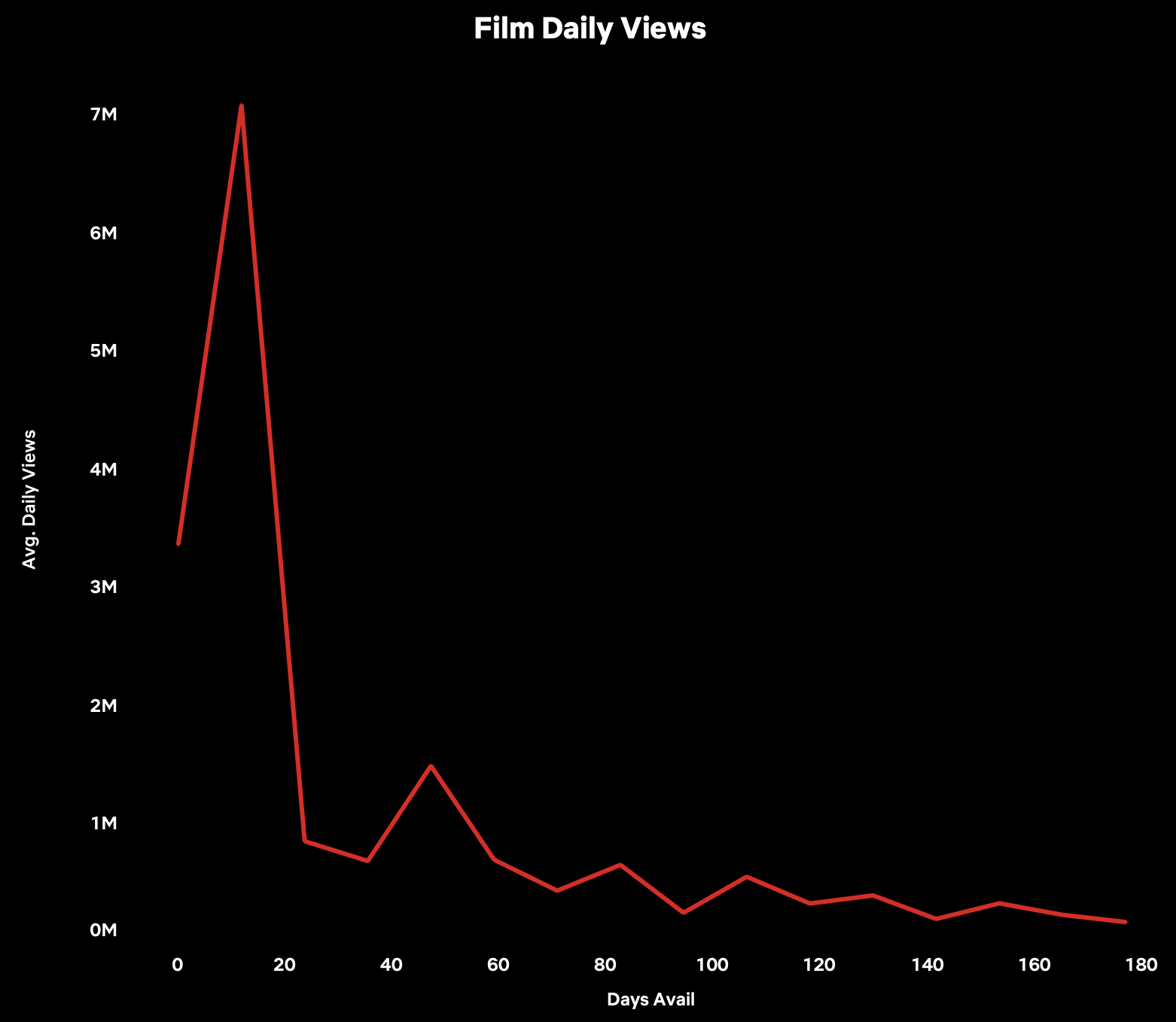
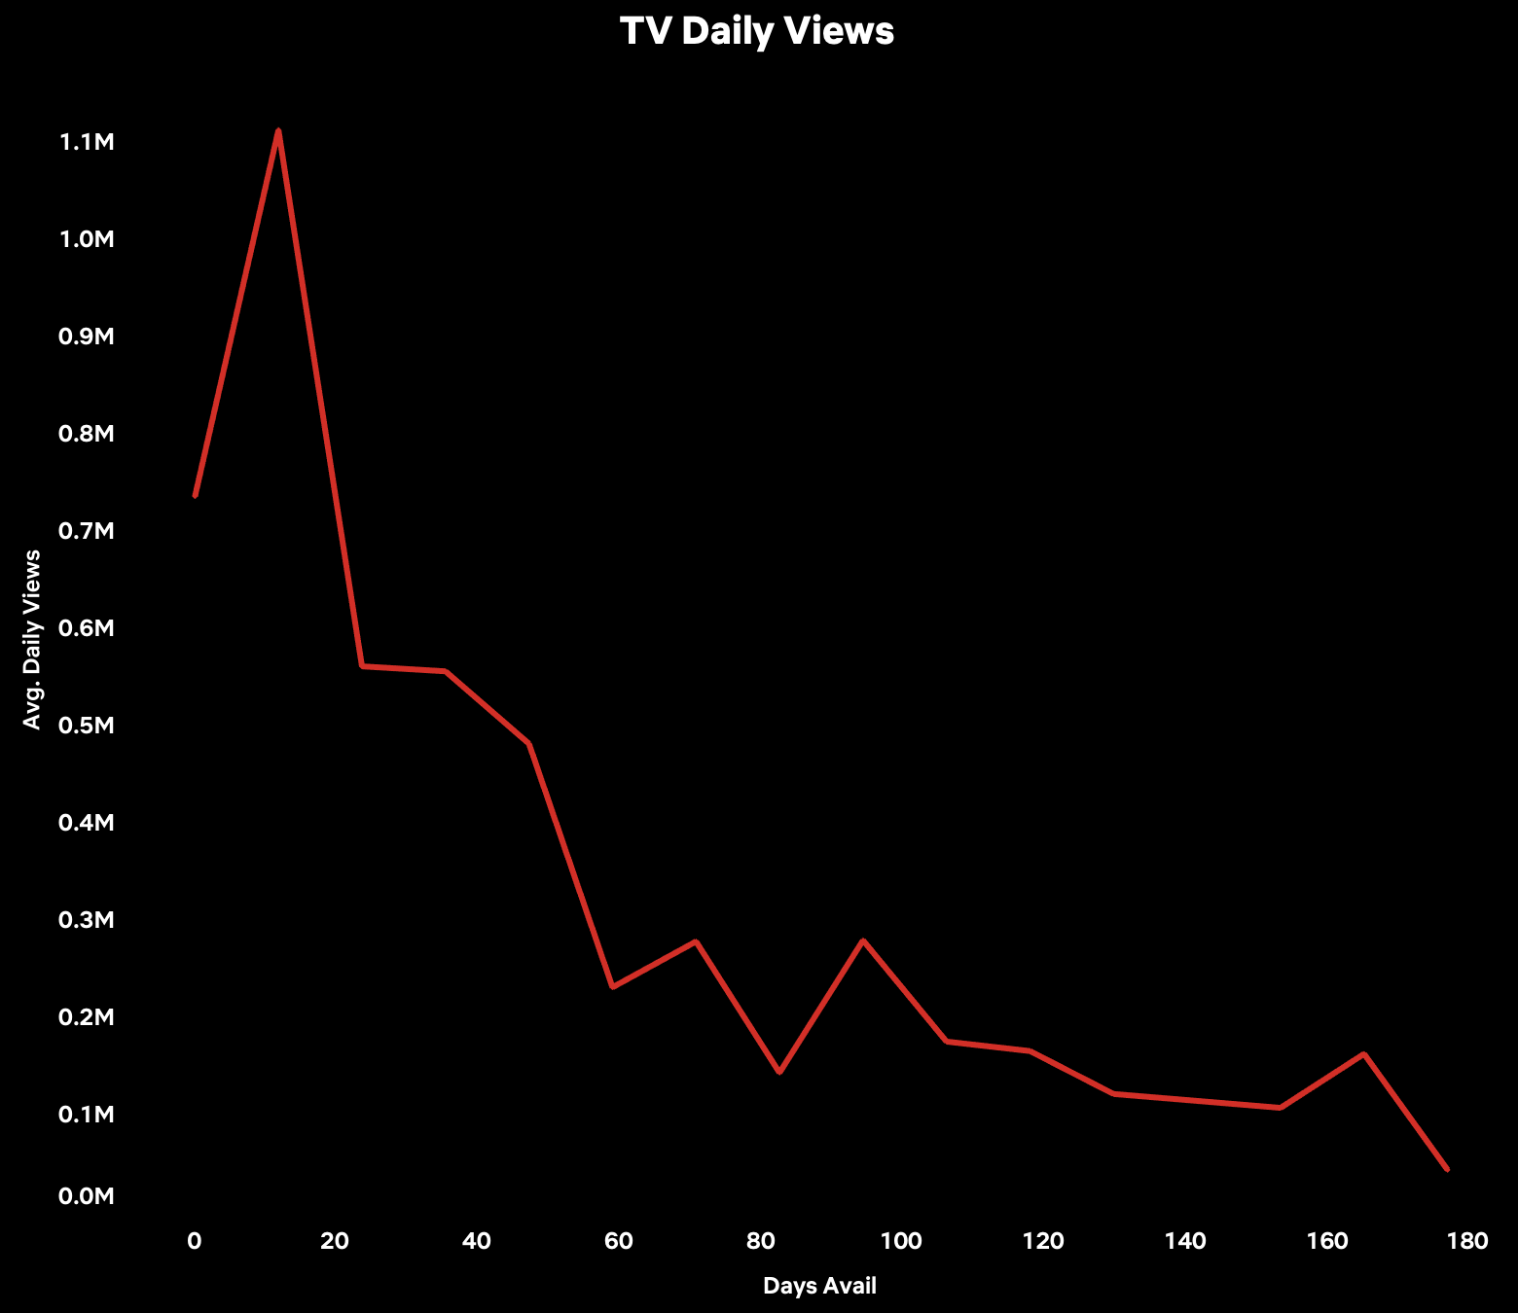
Films experience significant diminishing returns, but hit shows remain popular.
Although films receive much higher peak viewership on Netflix, TV shows don’t drop off as sharply and display greater longevity as time passes from the release of each season.

Slide 11
Recommendations and Next Steps

Slide 12
Recommendations
Acquire recently released crime & action flicks:
After less than a month on Netflix, most films fall below 1M views per day.
Lower costs by acquiring titles that just finished their theatrical runs.
Continue to partner with stars:
Cast high-level actors to promote films and drive engagement.
Renew existing shows and adapt IP for television:
Focus on projects that benefit from prior audience awareness.
New seasons of existing shows help retain current subscribers.
IP and infamous true crime stories catch pre-existing fans.
Increase children’s content production:
Make Netflix a parent’s best option for entertaining their kids.
License classic sitcom and crime shows:
The aforementioned 8 hits account for nearly 350M views (11% of grand total).
Increasing availability will prevent churn.

Slide 13
Next Steps
Improve data quality:
Obtain retention data to better understand allocation of hours viewed across titles
Incorporate global & regional availability
Include additional dimensions:
Segment viewing by genres
Explore language data and investigate relationship with viewership
Mix in marketing spend
Investigate less successful titles:
Understand why certain Netflix originals weren’t as popular
Finalize Tableau dashboard:
Develop and dive into the Tableau dashboard with the strategy team for further insights and recommendations

Slide 14
Appendix

Slide 15
Technical Process
Dataset stats:
18,214 unique titles present in the raw dataset
Top 500 titles by hours viewed were analyzed
Data points available:
Within raw data
title, hours viewed, release date, global availability, produced by Netflix
Scraped from IMDB
genres, languages spoken, episode count, prod. company country
Calculated
total views, views per day, views per episode, watch rate, rankings
Technical Process:
Loaded data into Python, scraped and joined IMDB data
Queried data and calculated statistics in BigQuery
Created dashboard in Tableau

Slide 16
Caveats
Assumptions
240m global Netflix subscribers
Netflix rounded each title to the nearest 100k hours
Titles without release dates were avail for the max. 180 days
Every hour contributes to a complete viewing of a title (i.e., no partial viewings)
Missing/Inconsistent Data
Little Angel Vol. 1 & 2 did not have IMDB pages and were excluded from Top 500 analysis
Runtimes on IMDB were sometimes imprecise
Data Validation
Python package for IMDB scraping did not always scrape correct title
11 titles required manual input of IMDB ID#, 21 titles required manual respelling
Python package broke after initial Top 500 scrape
Analysis below Top 500 is not currently possible

Slide 17
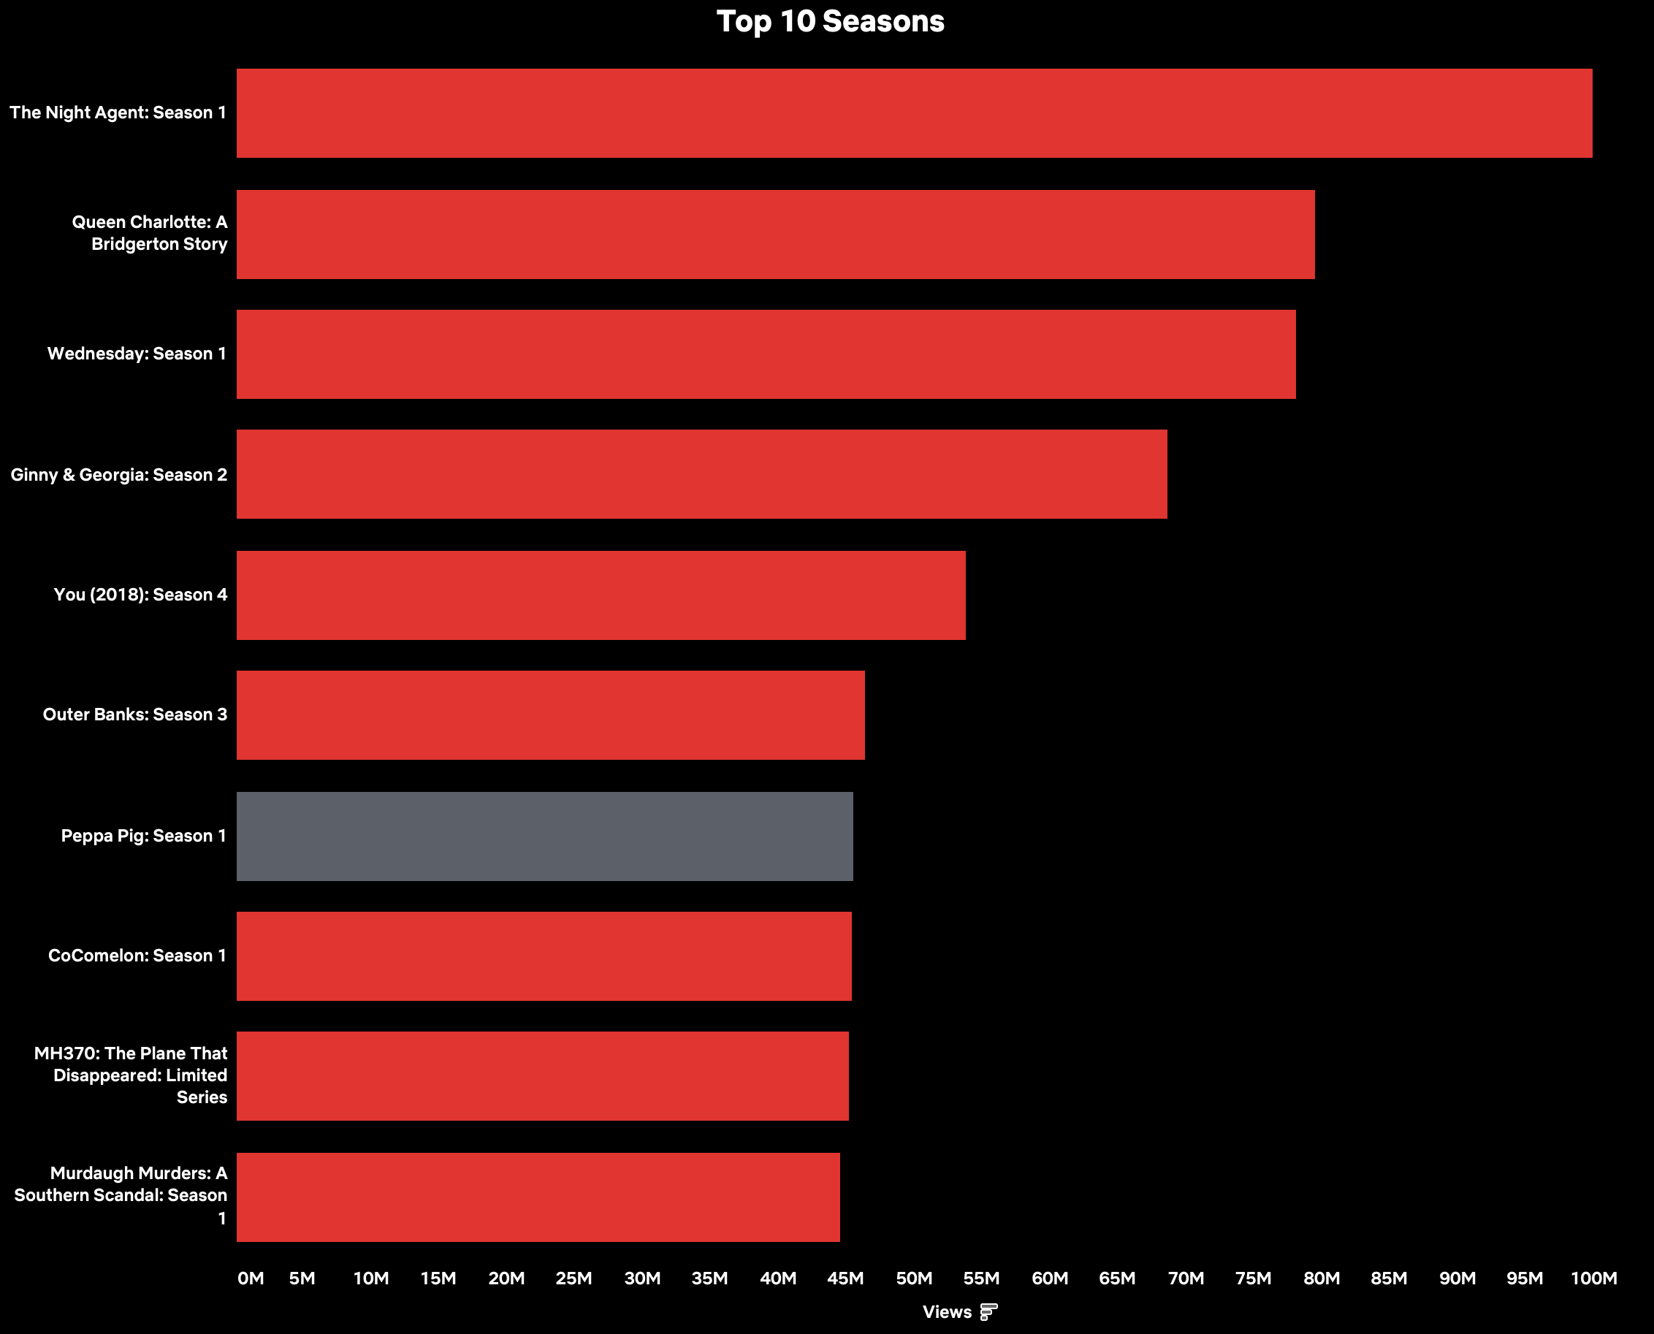
Additional Data – Top 10 Seasons

Slide 18
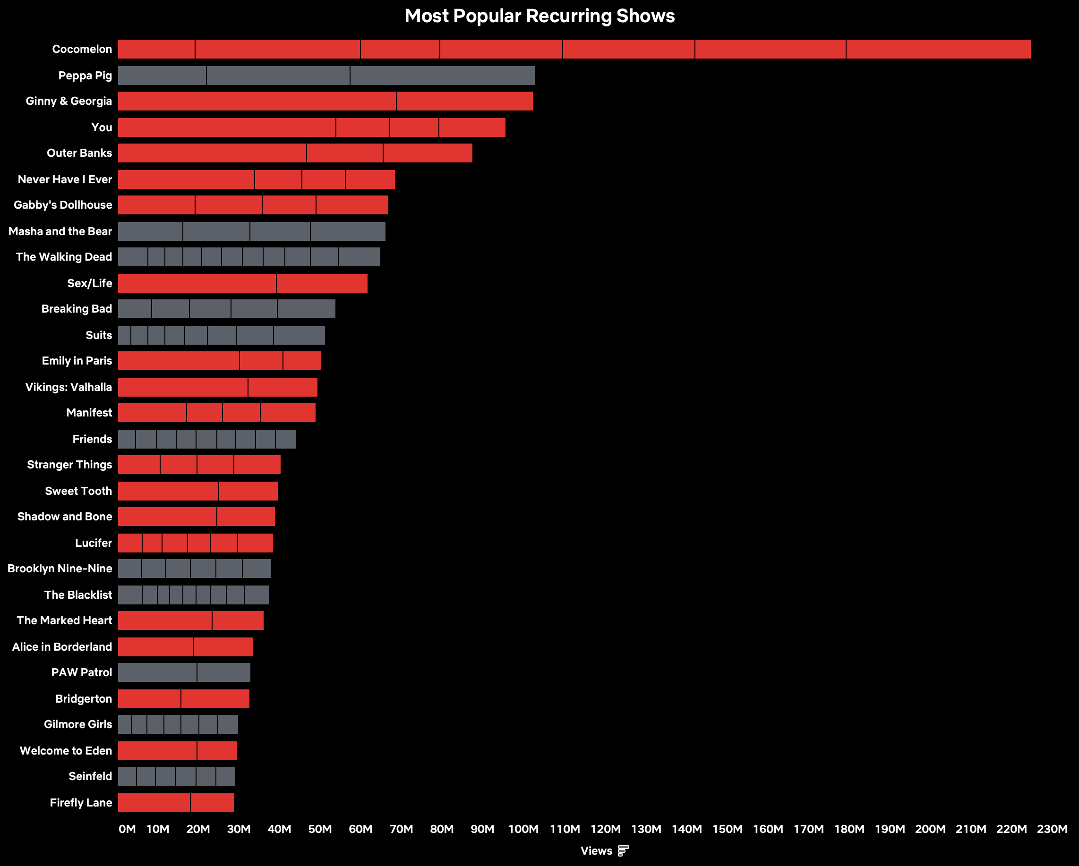
Additional Data – Top 30 Recurring Shows

